Slide 1


Data Analysis on Contoso Retail DW Business Intelligence and Visualization Using Multidimensional OLAP Cube and MS Data Tool
Guided By: Presented By:
Prof. Sunnie Chung Shrivastava Kajal
ID:2861721
Shaikh Mohammed Ovesh
ID:2860166

Slide 2

Agenda
Introduction to DataWarehouse
OLAP
Platform Settings
Data Description
Steps in designing CUBE
Deploying CUBE
MDX Query
Conclusion

Slide 3
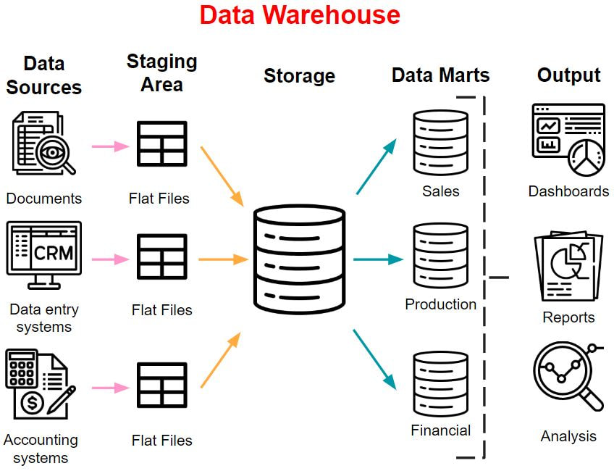
Introduction to Data Warehouse
Centralized repository
Stores data from multiple information sources.
Transforms into multidimensional data model.
Efficient querying and analysis.

Slide 4
Online Analytical Processing (OLAP)
Technology which is used to organize large business databases and support business intelligence.
Optimized for querying and reporting.
OLAP databases are divided into one or more cubes, and each cube is organized and designed by a cube administrator to fit the way that you retrieve and analyze data.
OLAP is used for decision-support systems to analyze aggregated information for sales, finance, budget, and many other types of applications.
It us with a very good view of what is happening but can not predict what will happen in the future or why it is happening.

Slide 5
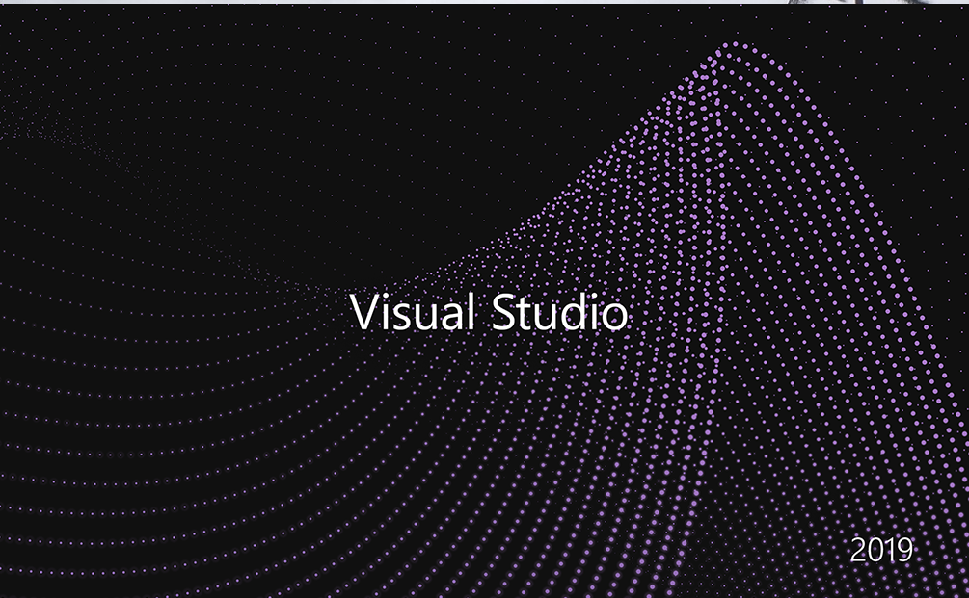



Platform Settings
SQL Server Management Studio 2019
Microsoft Visual Studio with MS SQL Server Data Tool (SSDT) Package
Microsoft SQL Server 2019 with Analysis Services.
Note: Multidimensional mode configuration

Slide 6


DATA DESCRIPTION:
For this project, we have taken dataset ContosoRetailDW.bak from
ContosoBIdemoBAK.exe
https://www.microsoft.com/en-us/download/details.aspx?id=18279
Contoso Database is a sample dataset that Microsoft provides as a data analysis study. It simulates a company's sales data.
The Contoso BI Demo dataset is used to demonstrate DW/BI functionalities across the entire Microsoft Office product family. This dataset includes C-level, sales/marketing, IT, and common finance scenarios for the retail industry and support map integration.
The dataset consists of 17 Dimension Tables and 8 Fact Tables.
It consists of tables such as DimAccount, DimCustomer, DimGeography, DimProduct, DimDate, DimPromotion, FactSales, FactInventory, FactOnlineSales, etc.

Slide 7
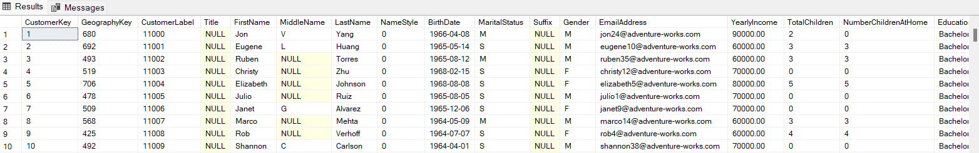
Entries in DimCustomer Table
Sample 10 rows of DimCustomer is shown.

Slide 8
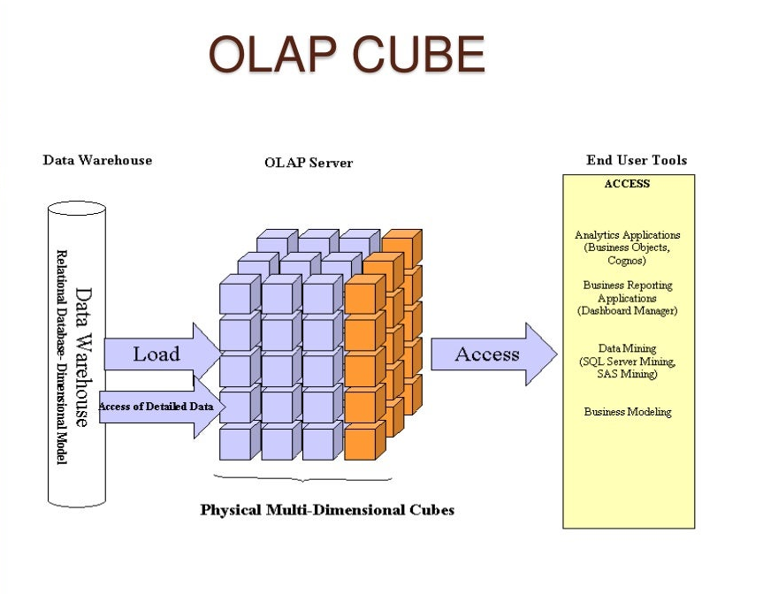
.
OLAP Server: It manages the OLAP cube and is responsible for processing queries, aggregating data, and delivering results for multidimensional analysis. OLAP Cube: is a specific implementation of a multidimensional database structure designed for efficient querying and analysis.

Slide 9
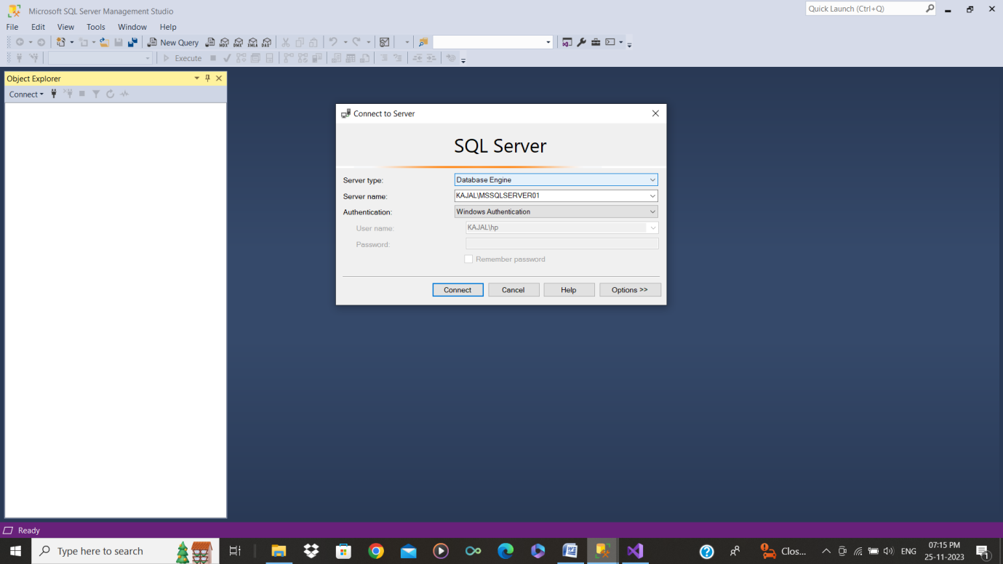
Importing the ContosoRetailDW
Open SSMS and select the server type as Database Engine from and the server name.

Slide 10
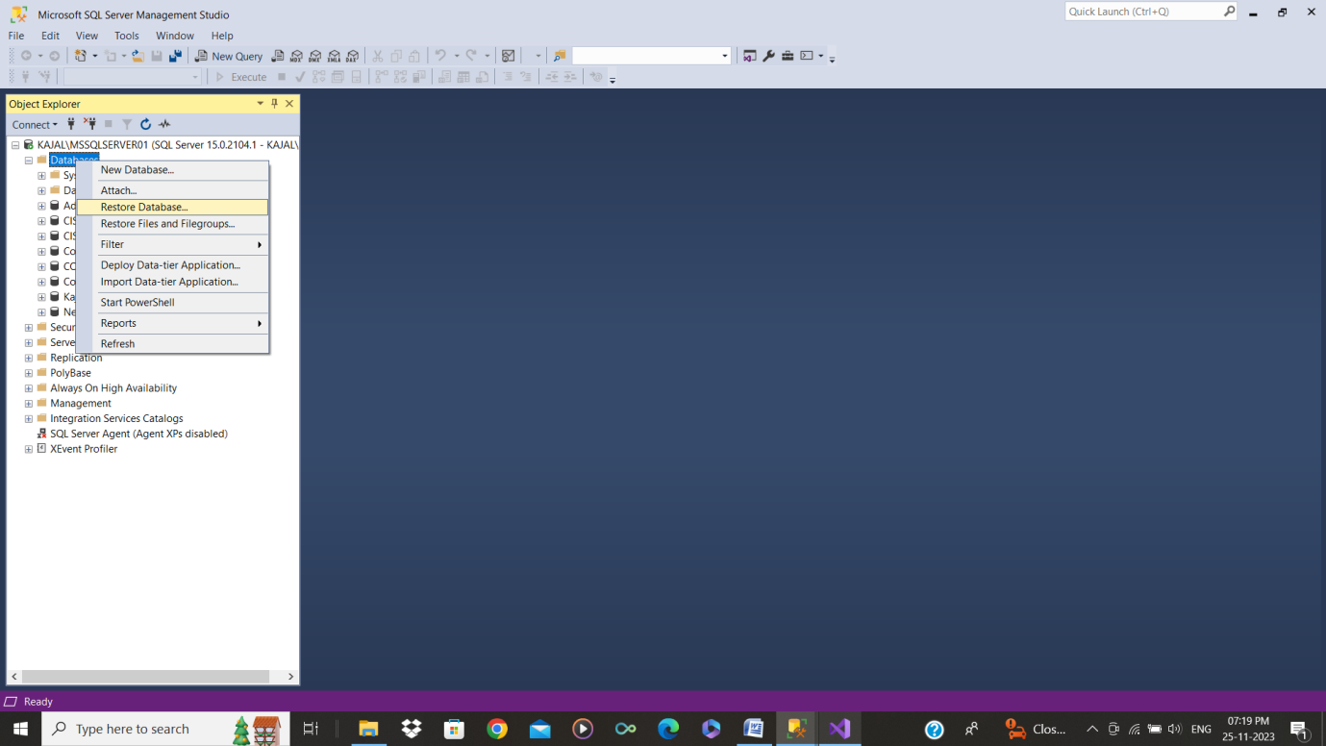
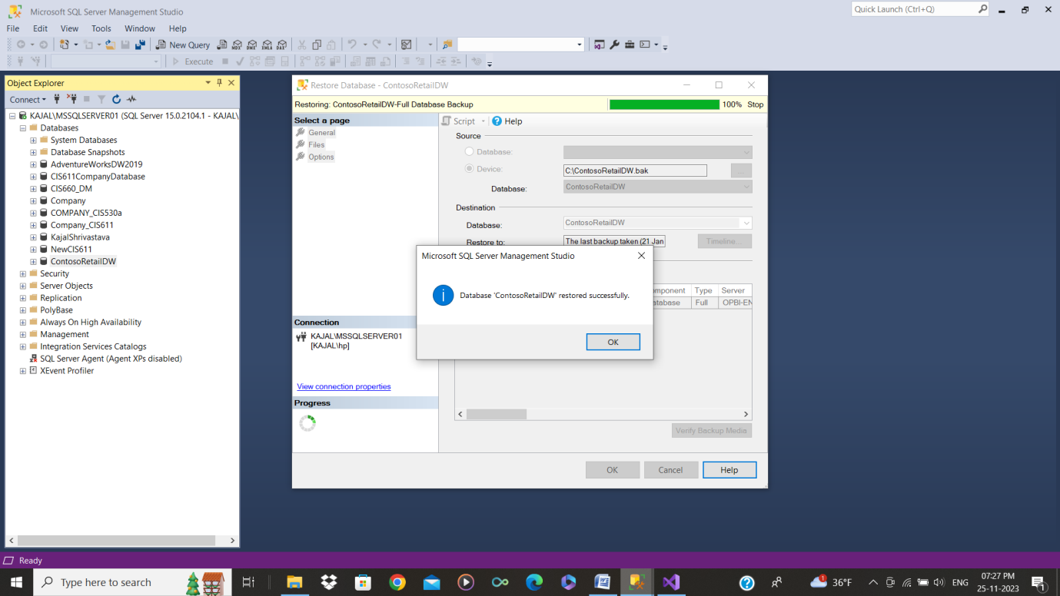
Restore the Database file ContosoRetailDW.bak

Slide 11
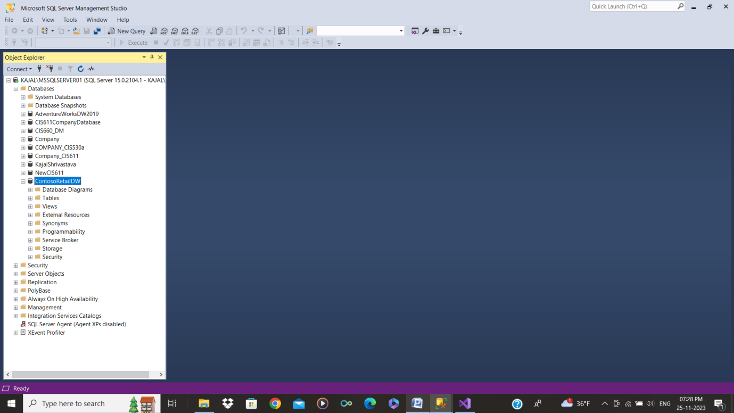
Here, you can see the ContosoRetailDW.
This will be the data source for creation of the CUBE.

Slide 12
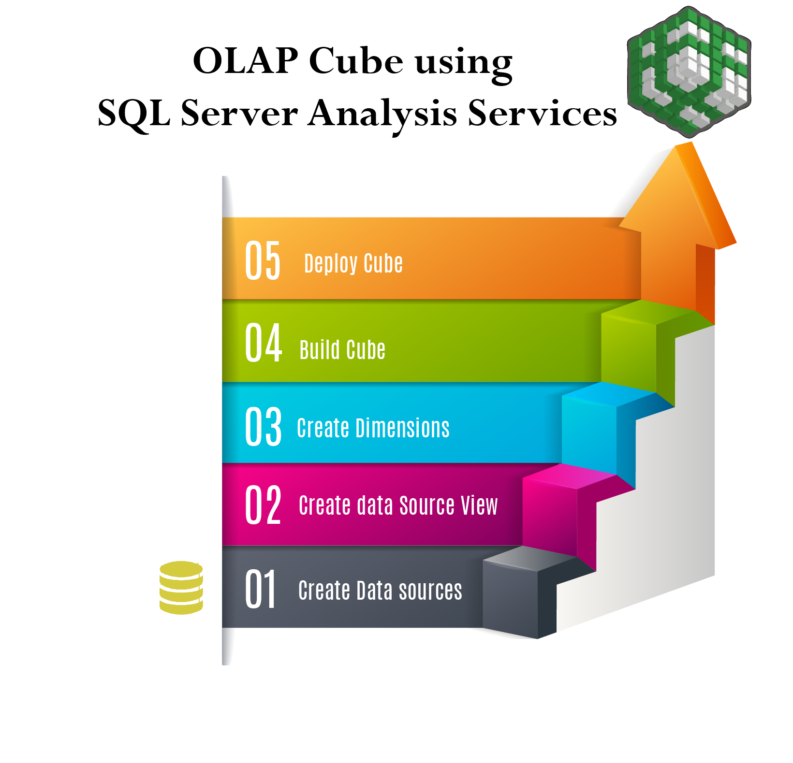
Stages of Designing a CUBE
Data Analysis on Contoso Retail DW

Slide 13
Terminologies Used
Cube: OLAP Cube is the basic unit of storage for Multidimensional data, on which we can do analysis on stored data and study the various patterns.
Dimensions: The primary functions of dimensions are to provide Filtering, Grouping and Labeling on your data. Dimension tables contain textual descriptions about the subjects of the business. Dimensions in general we can say are the Master entities with related member attributes using which we can study data stored in OLAP Cube Quickly and effectively.
Measure & Measure Groups Metrics value stored in your Fact Tables is called Measure. Measures are used to analyze performance of the Business. Measure usually contains numeric data, which can be aggregated against usage of associated dimensions. Measure Group holds collection of related Measure.

Slide 14
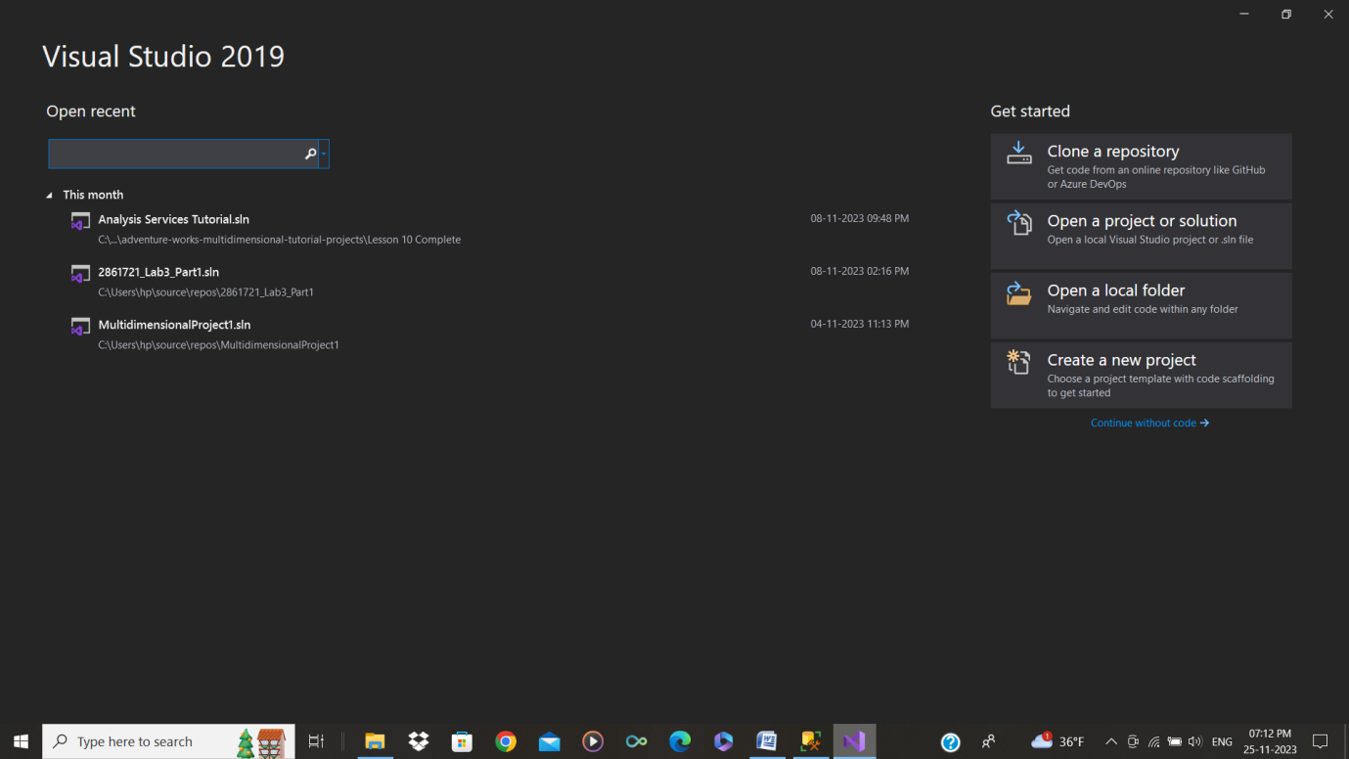
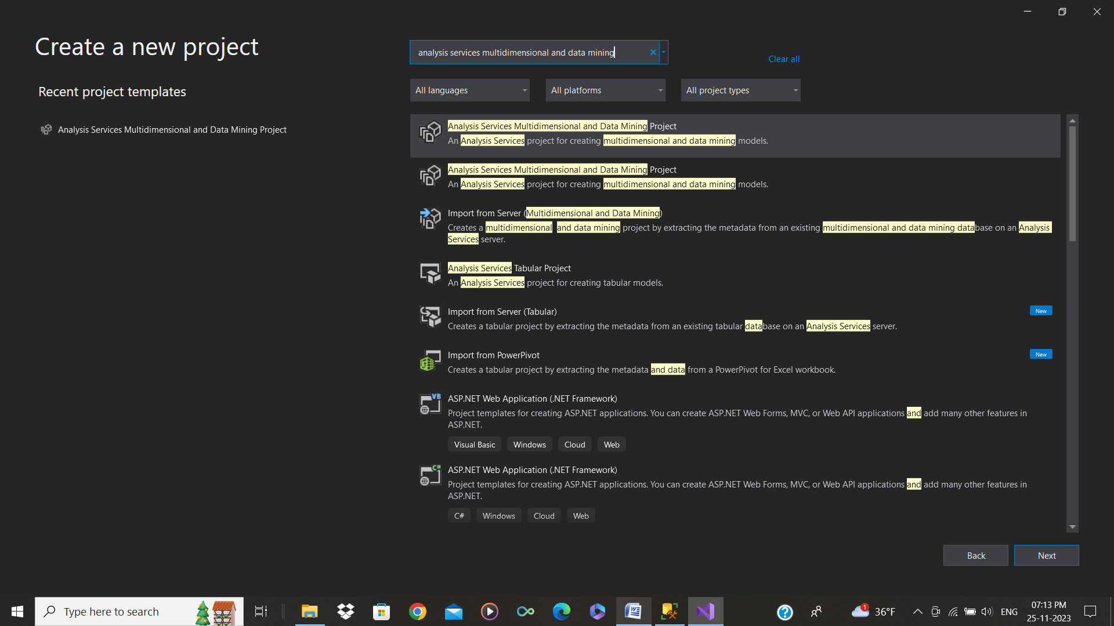
Starting with Creating Project
1. Open Visual Studio
2. Create a New Project
3. Search for Analysis Service Multidimensional and Data Mining Project. Select and Click Next.

Slide 15
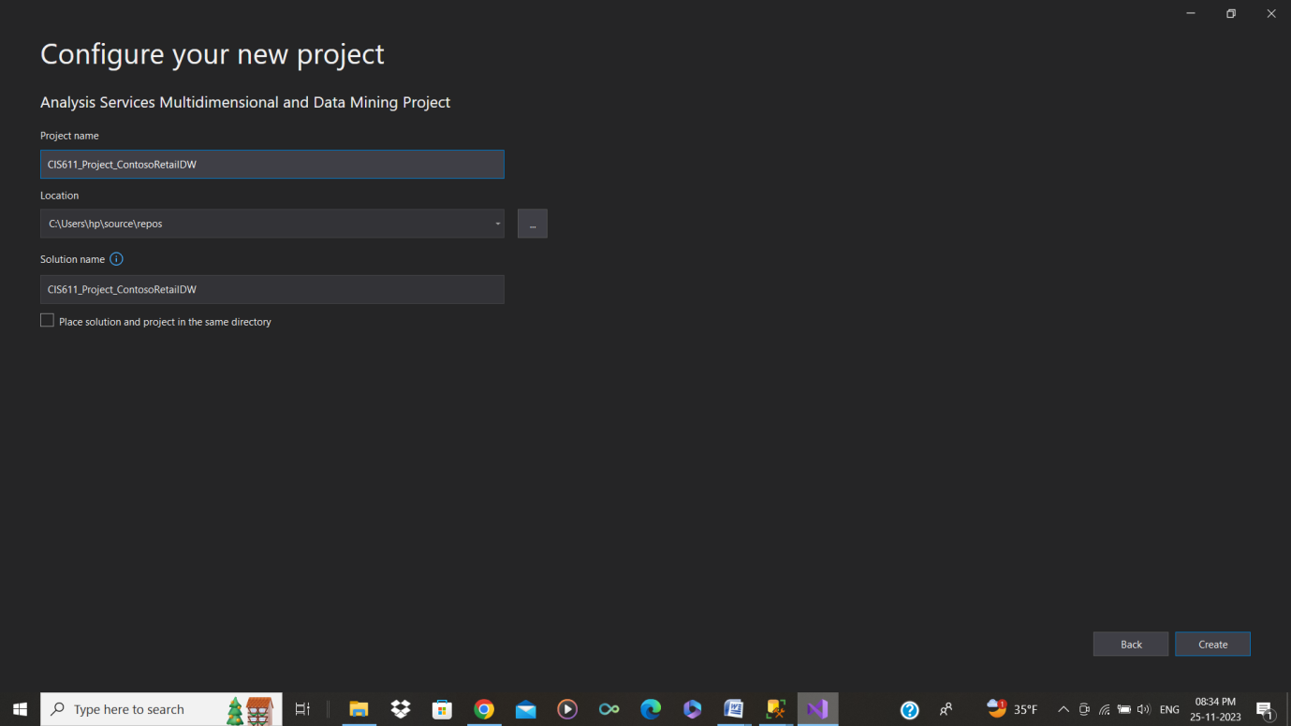
Starting with Creating Project
4. Give the Project name and create the project.
Created a new project with name of ‘CIS_611_ContosoRetailDW’

Slide 16
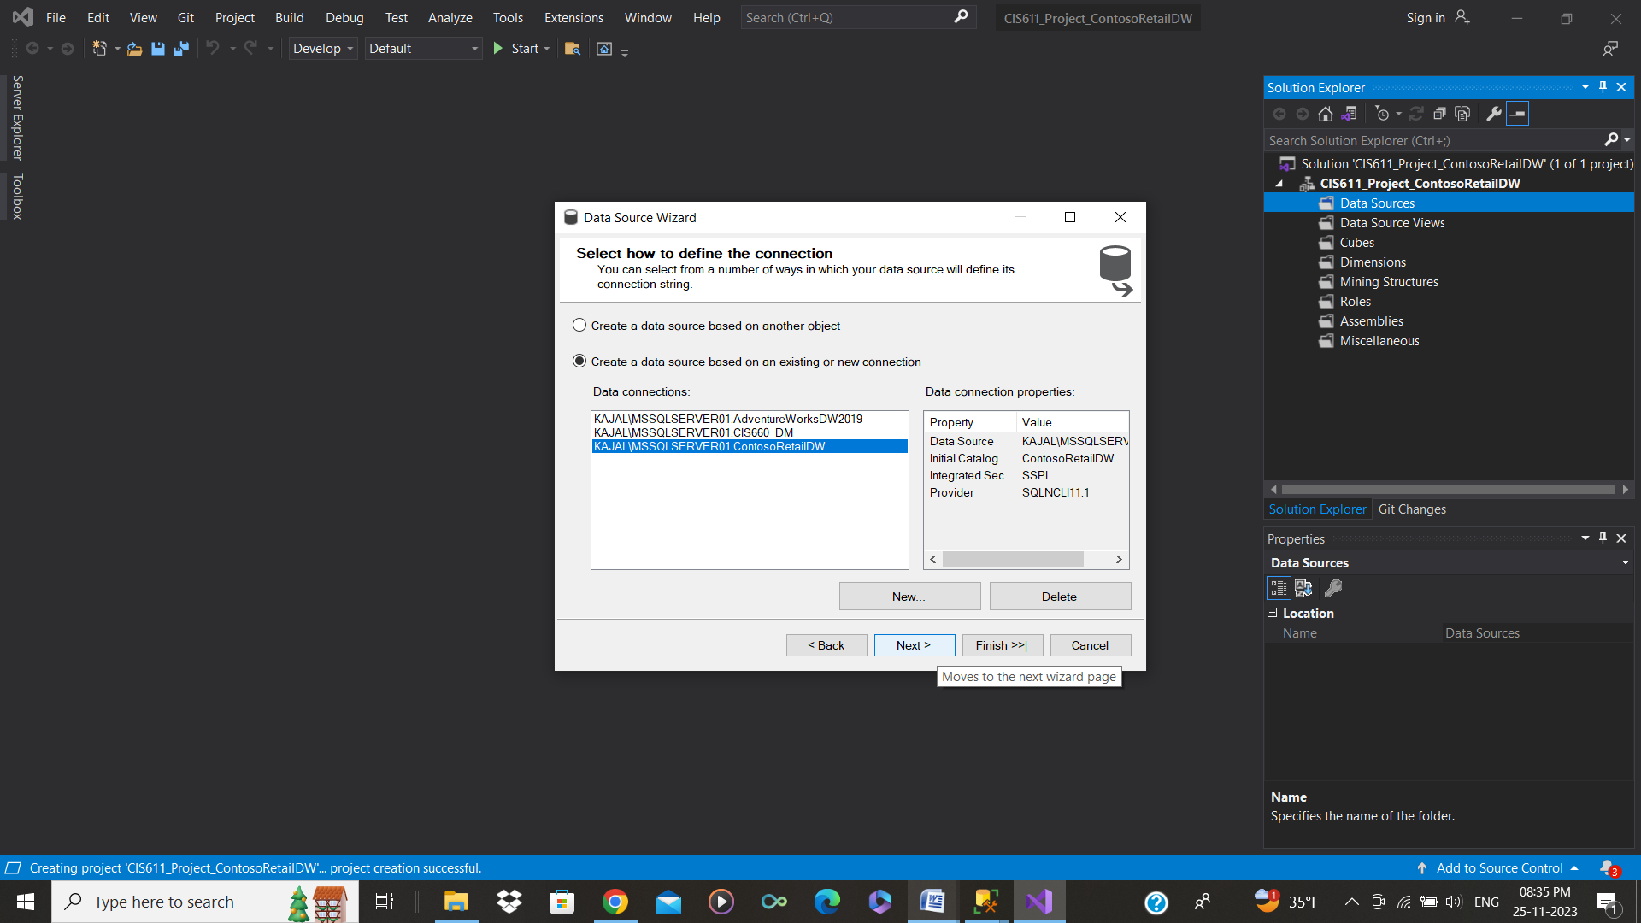
Creating New Data Source
Retrieving the data from SQL Server Database
5. For Creating New Data Source
This window will ask you to add from new connection or existing connection.
Especially select to Use the service account and then Click NEXT.

Slide 17
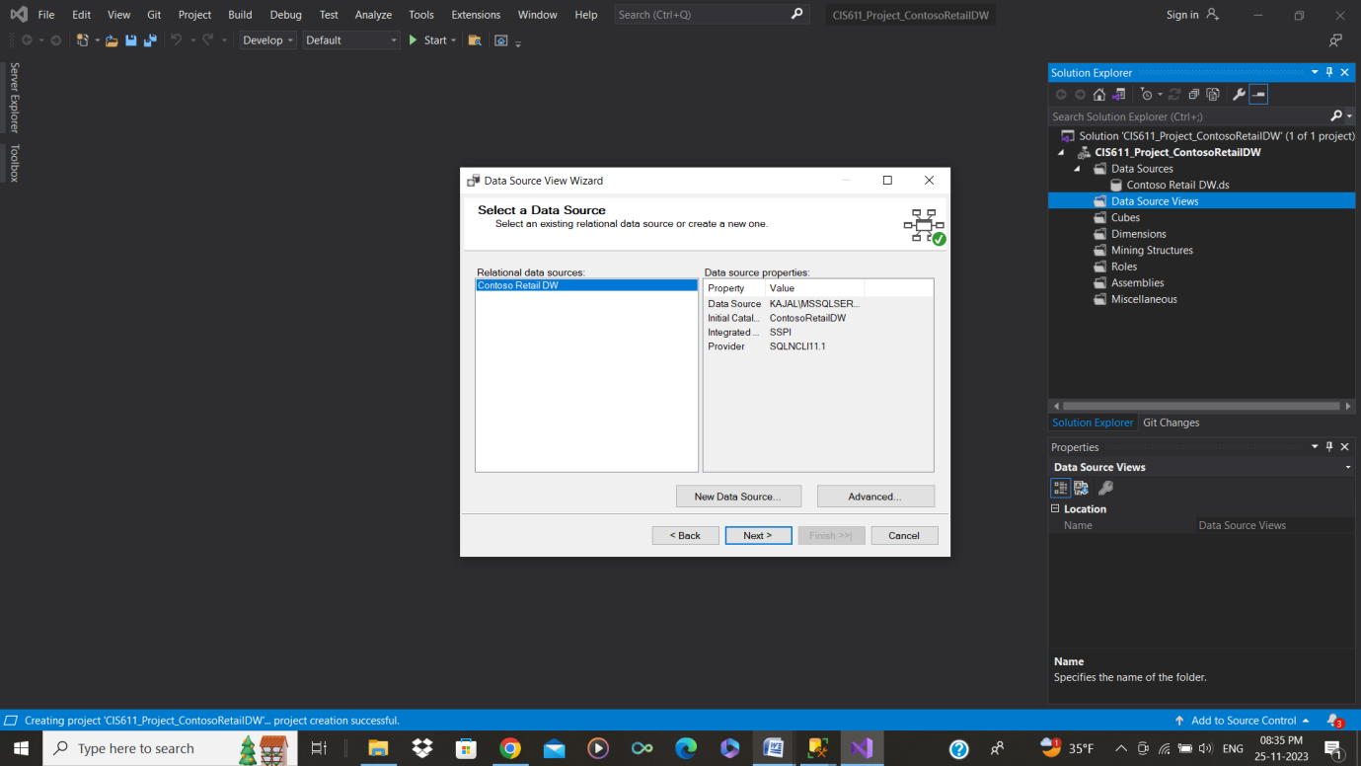
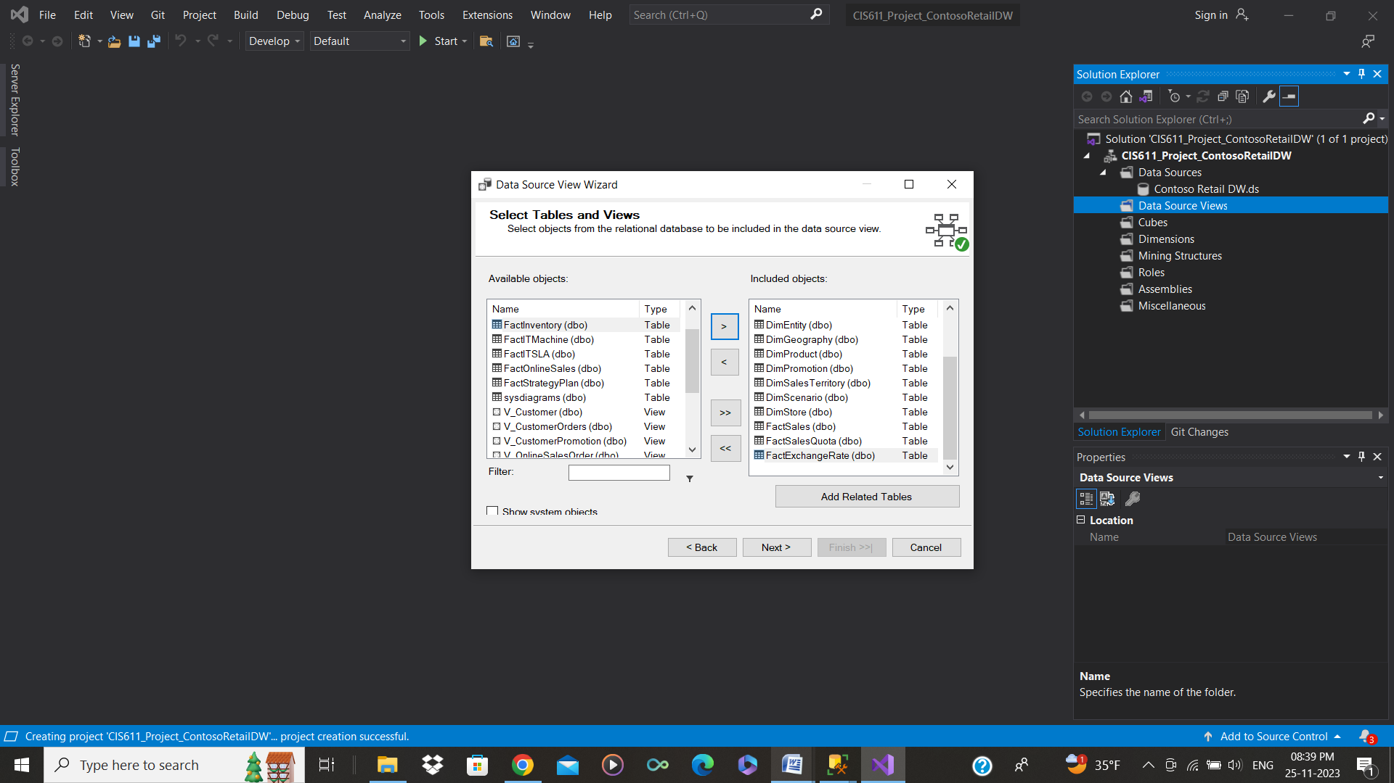
Create Data Source View (DSV)
Using the data source we will create dsv to view and interact with the data using the SSDT IDE.
Defining DSV that specify how data from the source is mapped to the cube structure.
It shows that which Tables and views (Selecting Features) to be selected from the database in the left side and then after clicking next the selected tables and views will pop-up in the right side which determines the selected ones.
After that a window will pop-up, that’s shows a confirmation to complete the whole process. Click FINISH.

Slide 18
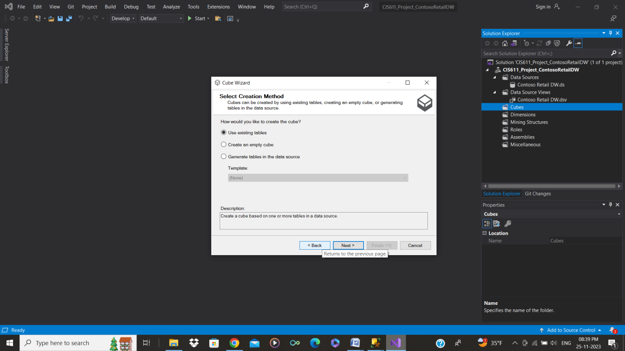
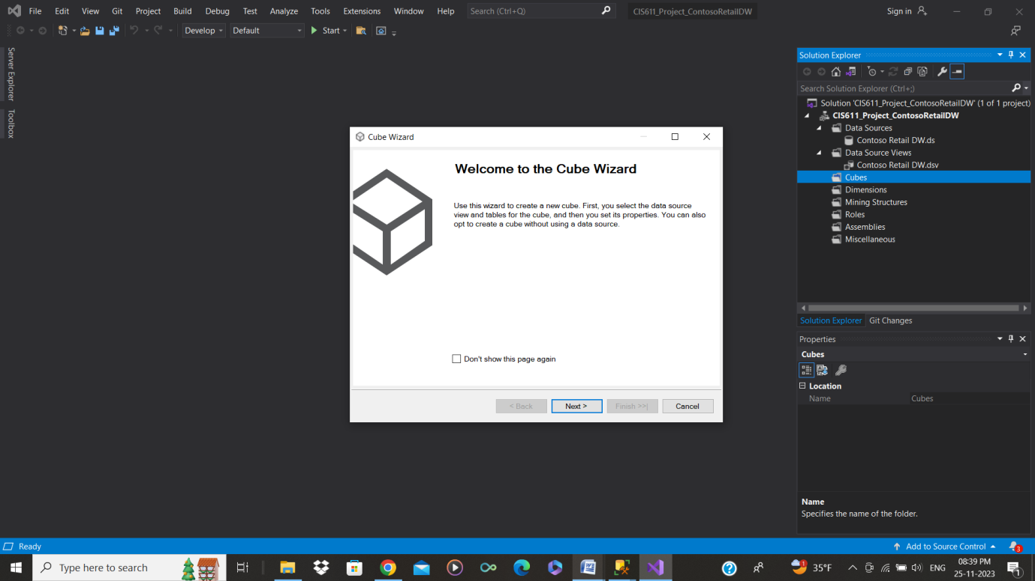
Creating the Cube Structure
Defining the cube by specifying dimensions, hierarchies, and measures.
Each cell represents a unique combination of dimension members. Measures are stored at the intersections of these dimensions.
Slicing, dicing, drilling down, and rolling up operations on the cube to navigate through the data along different dimensions and levels.

Slide 19
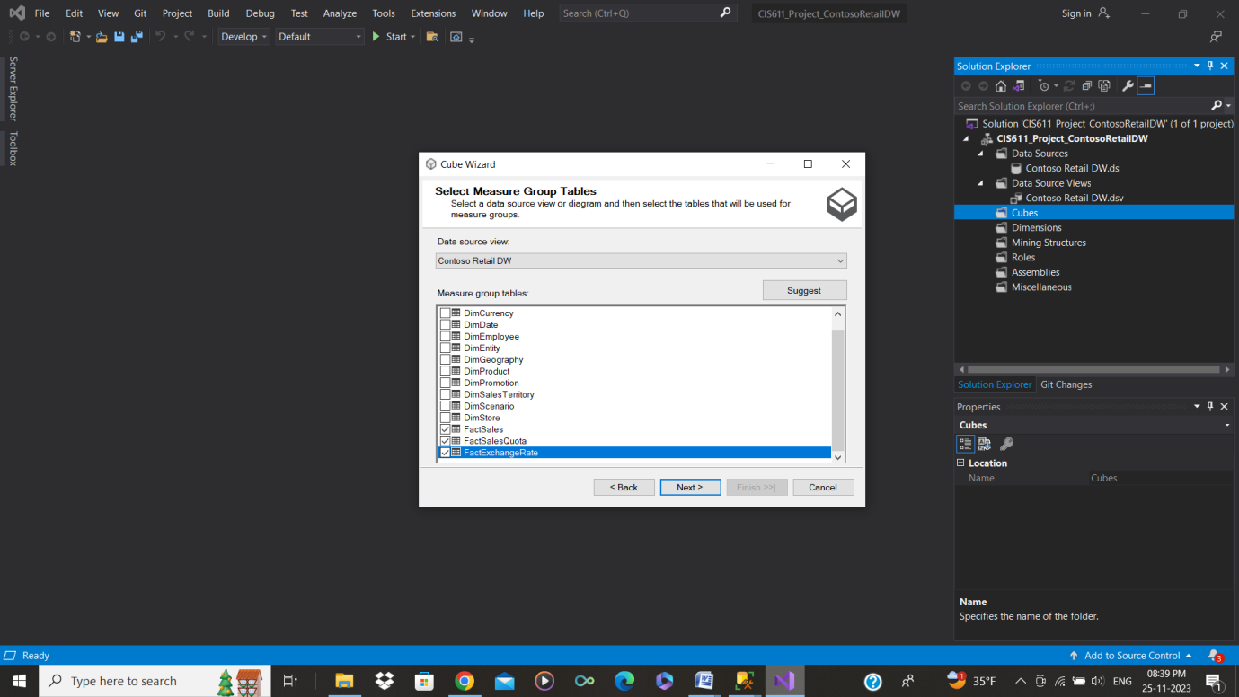
Select Measures
Determining the key performance indicators (measures) that will be analyzed within the cube (e.g., Sales, OnlineSales).
For Select Measure Group Tables, it means you have select which tables should be group in it. Like: FACT SALES, FACT SALES QUOTA, FACT EXCHANGE RATE.

Slide 20
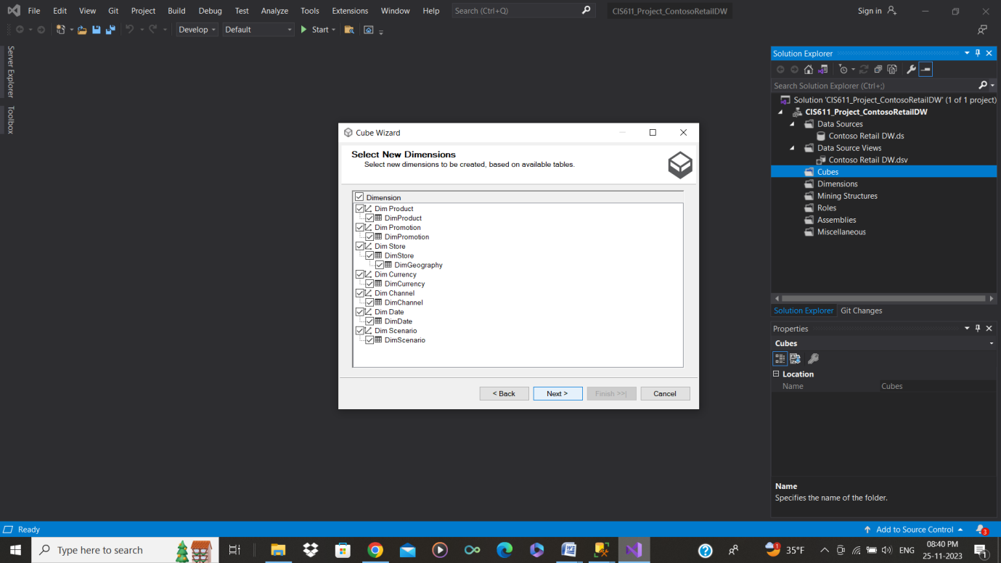
Identifying Dimensions and Hierarchies:
Identifying the dimensions that represent different aspects of the data (e.g., Date, Product, Geography).
Defining hierarchies within each dimension, specifying the levels of granularity.

Slide 21
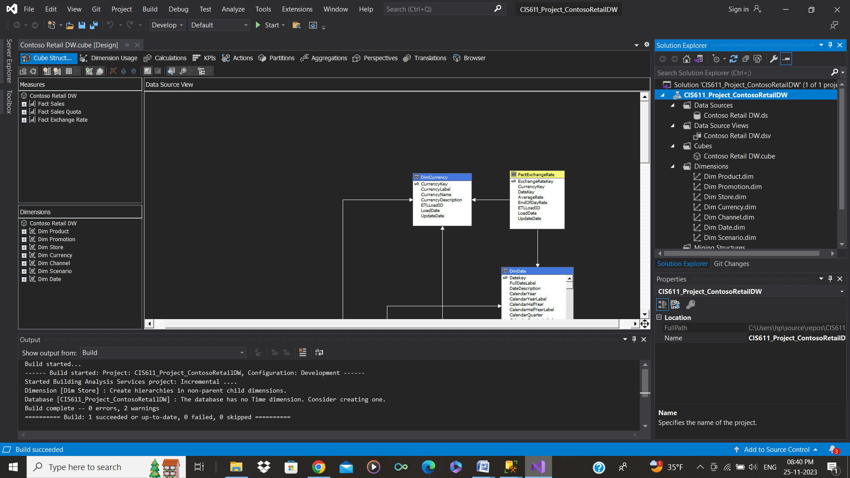
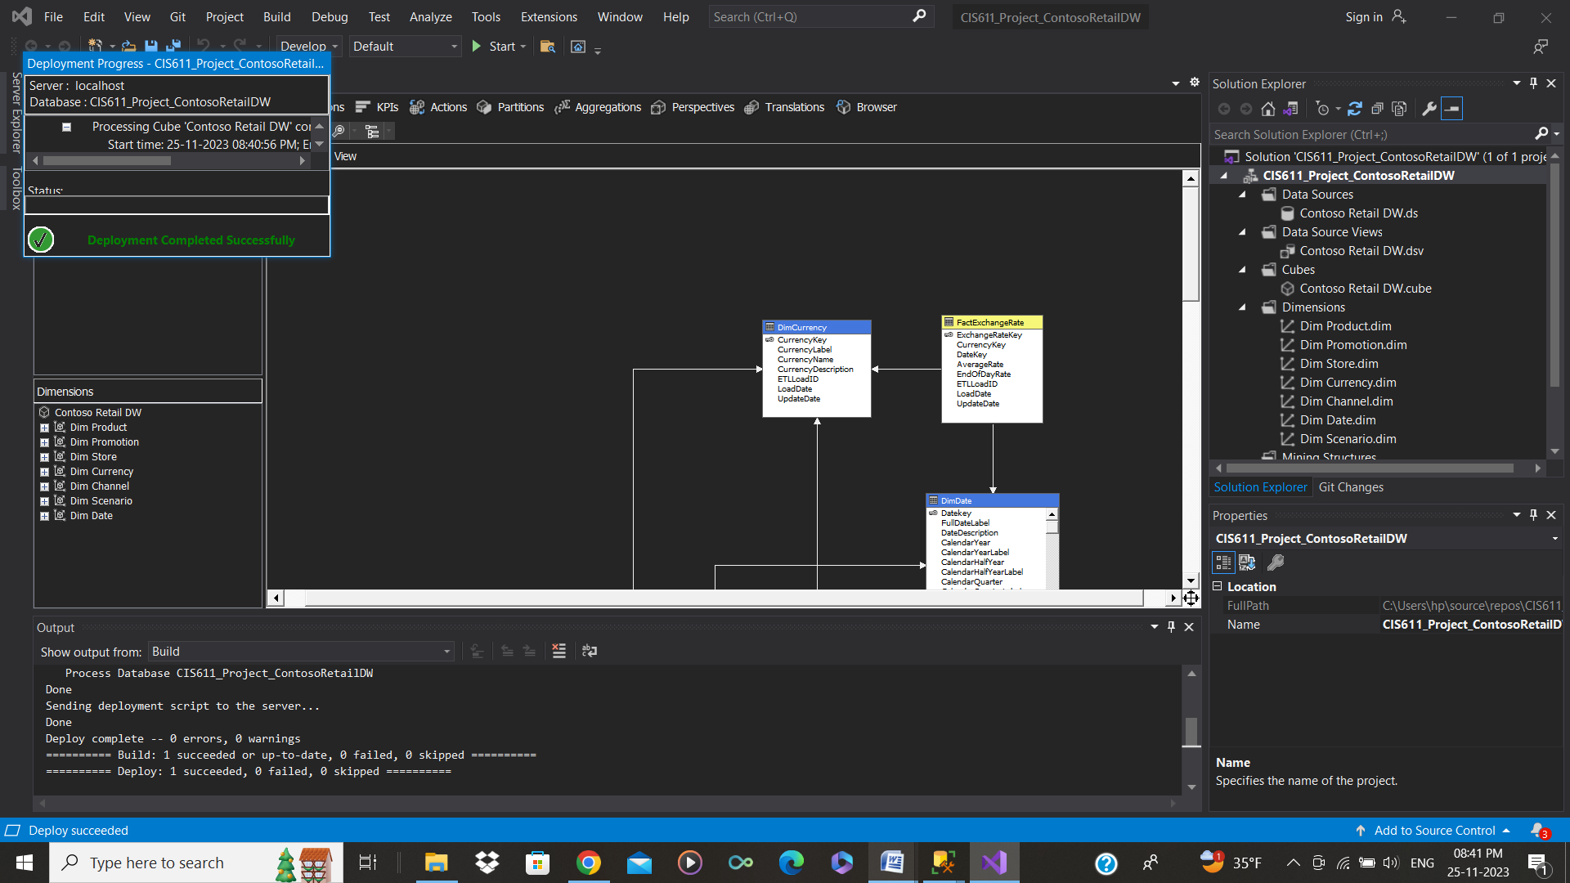
Deploy the Cube
Deploying the cube structure to an OLAP Analysis server for analysis over the cube.
Building the CUBE

Slide 22
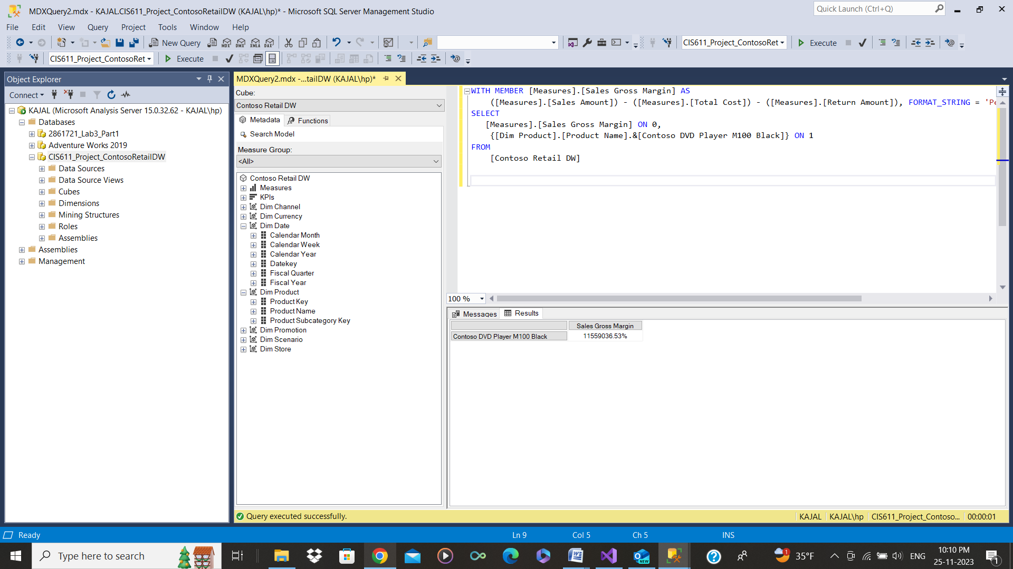
Querying Over the Obtained Cube
Executing MDX (Multidimensional Expressions) over the cube.
MDX is specifically designed for OLAP systems, allows users to formulate complex queries and retrieve data from the cube.
In this we have calculated the Sales Gross Margin for the Contoso DVD Player M100 Black
WITH MEMBER [Measures].[Sales Gross Margin] AS
([Measures].[Sales Amount]) - ([Measures].[Total Cost]) - ([Measures].[Return Amount]), FORMAT_STRING = 'Percent'
SELECT
[Measures].[Sales Gross Margin] ON 0,
{[Dim Product].[Product Name].&[Contoso DVD Player M100 Black]} ON 1
FROM
[Contoso Retail DW]

Slide 23
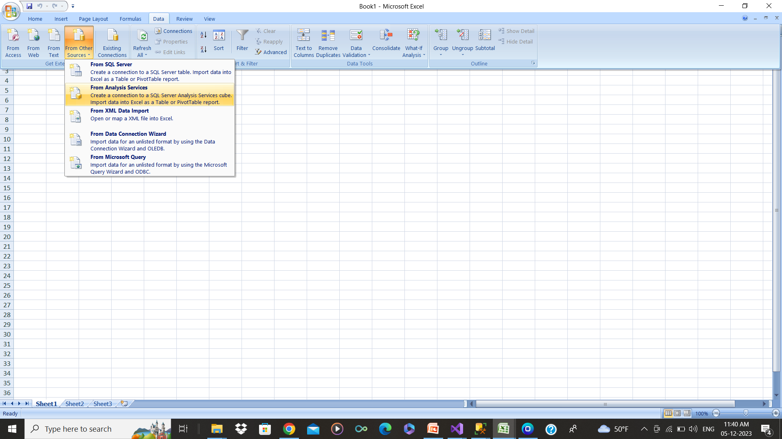
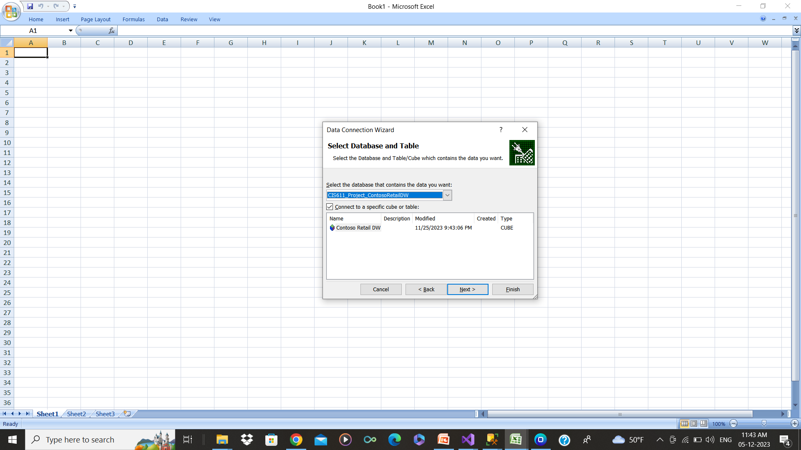
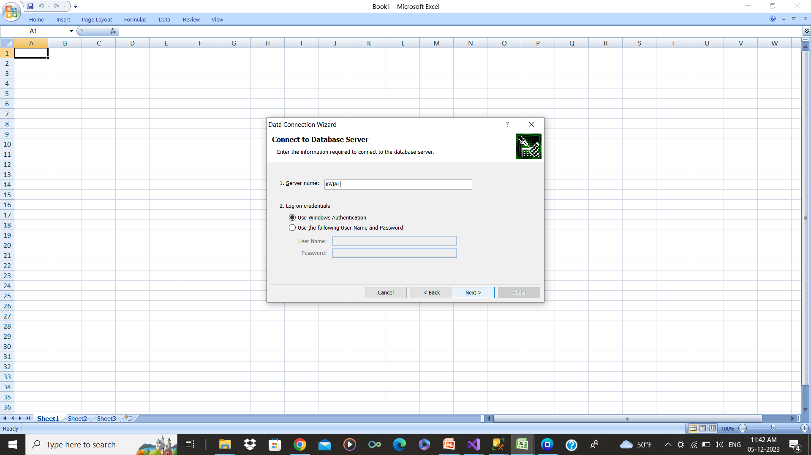
Visualization of the Analysis Using Excel
Note:- Select the name of analysis server.

Slide 24
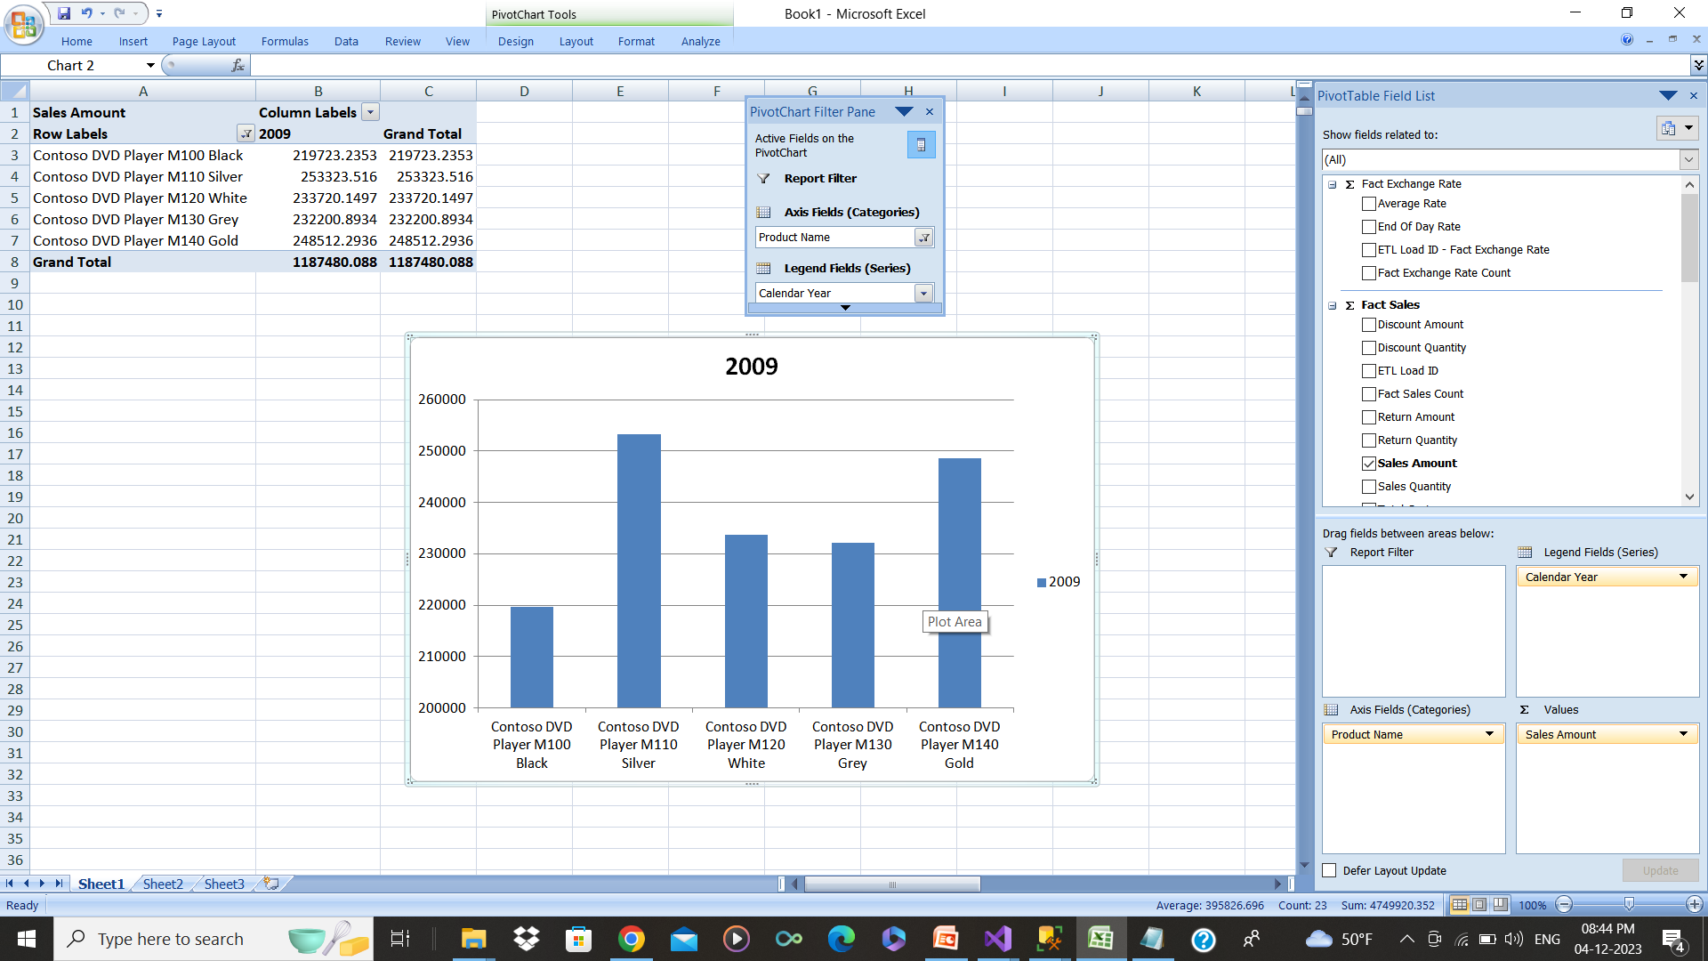
Visualization of the Analysis
From this we can analyse that In 2009 the sales of Contoso DVD Player M110 Silver is the Highest.

Slide 25



Conclusion
We have implemented a robust Business Intelligence (BI) and visualization solution by utilizing a Multidimensional OLAP Cube and Microsoft Data Tools using a selected Data Warehouse. It will provide stakeholders with powerful analytical capabilities and intuitive visualizations to enhance decision-making processes.

Slide 26

SQL Server 2012 Tutorials - Analysis Services Data Mining
https://learn.microsoft.com/en-us/analysis-services/multidimensional-tutorial/lesson-2-2-defining-a-cube?view=asallproducts-al
https://learn.microsoft.com/en-us/sql/dmx/dmx-tutorials-analysis-services-data-mining?view=sql-server-ver16lversions

Slide 27


THANK YOU

